Slide 1
Extending diagnostic validity meta-analysis to several diagnostic guidelines
Henry C. Kwok¹, Fransiska R. M. Falconer¹, Alain C. Vandal²,
Andrew G. Hill¹, Andrew D. MacCormick¹
¹Te Whatu Ora Counties Manukau
² Presenter, Te Kura Tatauranga/Department of Statistics
Waipapa Taumata Rau/The University of Auckland

Slide 2
Before we start, an aside
The University of Auckland’s graduate Statistical Inference course has been “elevated” to include an individual research component.
Students taking this class were each given a scientific question to answer, a data set, and a technique or approach to use.
Example:
Is there a difference between Australian and New Zealand children’s ability in mathematics?
Use PISA data from 2023.
Use Rasch analysis to answer the question.

Slide 3
Before we start, an aside
Two reports: one on literature review and analysis plan, one on reporting results and discussion.
Nearly all students gravitated towards an R package to carry out the work.
When asked:
“Why didn’t you assess the Rasch assumption of specific objectivity?”,
the answer was
“The package couldn’t do it.”

Slide 4

Back to our original programme…

Slide 5
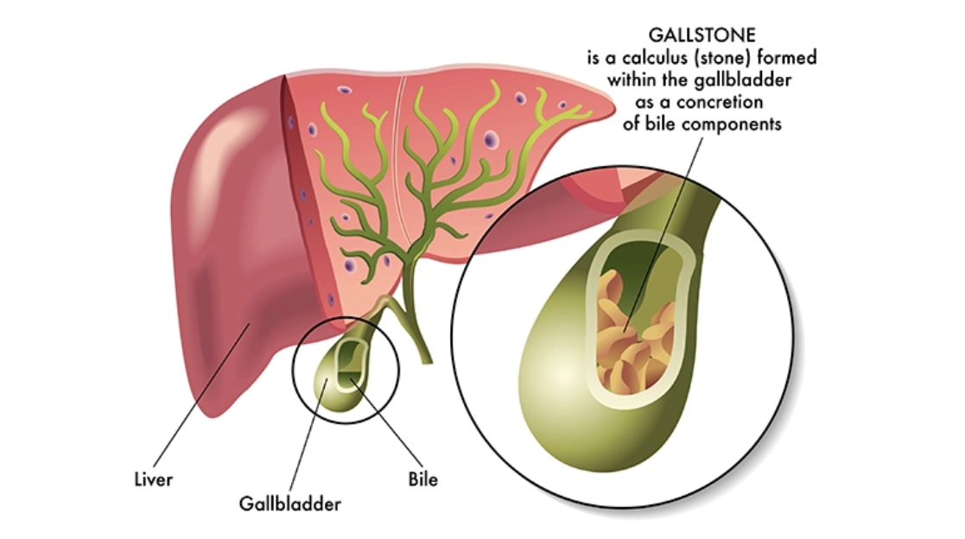
The Background
The presence of Common Bile Duct Stones (CBDS) in 5% to 20% of patients with acute biliary disease complicates their surgical treatment and increases their morbidity.
https://www.drdannyshouhed.com/cholelithiasis-choledocholithiasis

Slide 6
The Background
With such patients, clinicians need to ascertain the presence of CBDS prior to treatment by using diagnostic procedures.
The trade-off is that patients at low risk of CBDS should preferably not undergo these diagnostic procedures.
https://www.drdannyshouhed.com/cholelithiasis-choledocholithiasis

Slide 7
The Background
Gold standards for identification of CBDS are procedures known as ERCP, IOC, MRCP and EUS.
These procedures are variously risky, costly, resource-intensive and they prolong hospitalisation, and/or all of these at once.
CBDS screening guidelines have been devised to direct patients towards or away from these procedures.

Slide 8
The Background
Screening guidelines:
ASGE2010
ASGE2019
ESGE
American Society for Gastrointestinal Endoscopy
European Society of Gastrointestinal Endoscopy
Guidelines enable the classification of patients as having low, intermediate and high risk of CBDS.
They provide recommendations regarding any diagnostic procedure to undergo.

Slide 9
The Mission
Carry out a meta-analysis of the guidelines.
Measure of success: how well they predict CBDS or its absence, by threshold (low, intermediate, high).
Objective: to estimate meta-analytically the Area under the Receiver Operating Characteristic Curve (AUROC) of each of the guidelines.

Slide 10
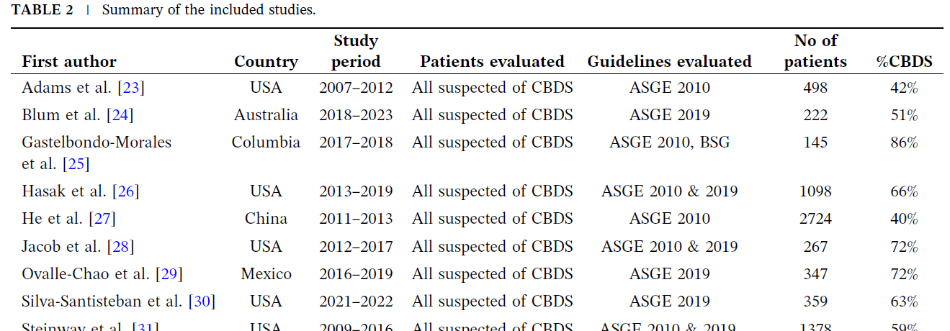
The Issues
Thirty-one studies were found.
Each reported on the performance of one or more guidelines.
Each reported on this performance at one or more thresholds.

Slide 11
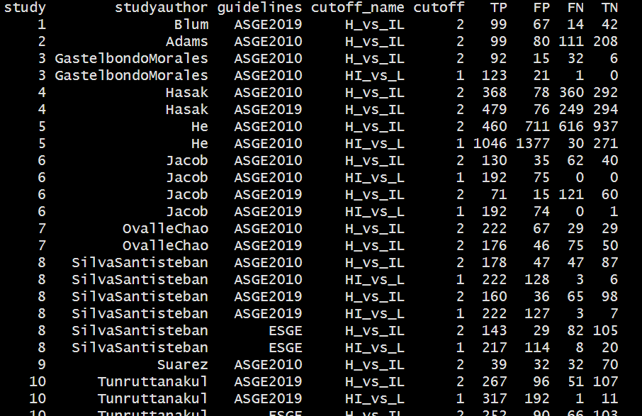
The Issues
Thirty-one studies were found.
Each reported on the performance of one or more guidelines.
Each reported on this performance at one or both thresholds.

Slide 12


The Main Tool
R package diagmeta (Rücker, S. Steinhauser, S. Kolampally, & Schwarzer [2022]) was designed to deal with precisely this setup.
Idea: Fit a linear mixed effects model of
$$\text{logit}\left[\text{Specificity}(x_{si})\right]=α_{0}+a_{0s}+\left(β_{0}+b_{0s}\right)x_{si}+e_{si}$$
$$\text{logit}\left[1−\text{S}\text{ensitiv}\text{ity}(x_{si})\right]=α_{1}+a_{1s}+\left(β_{1}+b_{1s}\right)x_{si}+f_{si}$$
where $a_{0s}, b_{0s},a_{1s},b_{1s}, e_{si}, f_{si}$ are random, $s$ is the study, $i$ the threshold index and $x_{si}$ the threshold.
TN
FN

Slide 13

The Main Tool
$$\text{logit}\left[\text{Specificity}(x_{si})\right]=α_{0}+a_{0s}+\left(β_{0}+b_{0s}\right)x_{si}+e_{si}$$
$$\text{logit}\left[1−\text{S}\text{ensitiv}\text{ity}(x_{si})\right]=α_{1}+a_{1s}+\left(β_{1}+b_{1s}\right)x_{si}+f_{si}$$
The observations are weighted according to their inverse variance.
Random effects variance matrix is unstructured.
Fitted values ${\hat{α}}_{g}+{\hat{β}}_{g}x_{si}$ are backtransformed with an inverse logit.
We elected to let $a_{0s}=a_{1s}=a_{s}$ and $b_{0s}=b_{1s}=b_{s}$ for a reason to be revealed and because standard errors did not seem to mind.
The package uses lme4::lmer to fit the models.

Slide 14
The Main Tool
This is some graphical output from diagmeta regarding the ASGE2019 guidelines:

Slide 15

The Extensions: Heterogeneity
Although not part of the package, the use of lmer enables the computation of threshold-specific intraclass correlation coefficients using the VarCorr function. For each guideline, we compute
$$\text{IC}{\text{C}}_{i}=\frac{\text{Var}[a_{is}+b_{is}×x_{i}]}{\text{Var}\left[a_{is}+b_{is}×x_{i}\right]+\text{Var}\left[e_{i}\right]}$$
Confidence intervals are obtained through the bootstrap or using the random effects Hessian.
(It’s convenient to let $a_{0s}=a_{1s}$ and $b_{0s}=b_{1s}$ in this setting.)

Slide 16
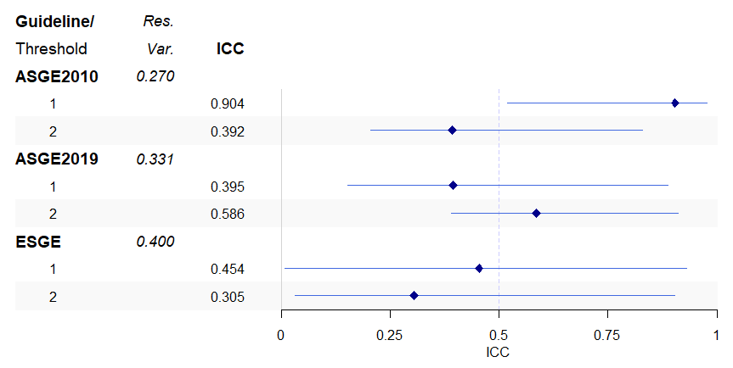
The Extensions: Heterogeneity
Study heterogeneity by guideline and threshold

Slide 17
The Extensions: Outliership
The models can be refitted to use regression diagnostic tools.
We compared studentised residuals with Benjamini & Hochberg thresholds.
We refitted the meta-regression models without the studies identified as sensitivity analyses.

Slide 18
The Extensions: Outliership
ASGE2010
ASGE2019
ESGE
Stud. res. | Study ID | Group | Thresh. | BH crit.
4.071 | 5 | 1 | 2 | 3.376
2.393 | 5 | 0 | 2 | 3.372
2.365 | 15 | 0 | 1 | 3.368
2.129 | 15 | 0 | 2 | 3.364
1.953 | 12 | 1 | 2 | 3.359
1.907 | 12 | 0 | 1 | 3.355
Stud. res. | Study ID | Group | Thresh. | BH crit.
2.910 | 13 | 0 | 2 | 3.302
2.539 | 13 | 1 | 2 | 3.296
2.338 | 16 | 0 | 2 | 3.291
1.919 | 12 | 0 | 1 | 3.285
1.902 | 22 | 1 | 2 | 3.279
1.740 | 22 | 0 | 2 | 3.273
Stud. res. | Study ID | Group | Thresh. | BH crit.
2.624 | 12 | 1 | 1 | 3.124
2.223 | 13 | 0 | 2 | 3.113
1.928 | 12 | 0 | 1 | 3.102
1.924 | 10 | 0 | 2 | 3.090
1.890 | 13 | 0 | 1 | 3.078
1.652 | 13 | 1 | 1 | 3.065
Stud.res: Studentised residual; Group 0: Specificity, 1:1-Sensitivity;
Thresh.: Threshold; BH crit.: Benjamini-Hochberg criterion

Slide 19
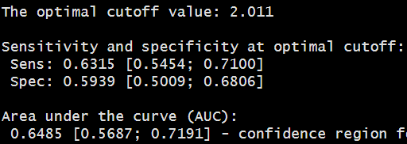
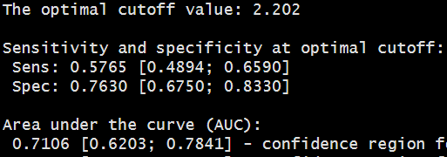
The Extensions: Outliership
Original ASGE2010 meta-analysis results
ASGE2010 meta-analysis results –
Study 5 removed

Slide 20
The Extensions: Comparing guidelines
By extracting and concatenating the data as wrangled by diagmeta, it is possible to test the null hypothesis that the guidelines are similar in terms of sensitivity and specificity.
Simply test
Outcome~Guideline*Group*Threshold+(Threshold|Study)
vs
Outcome~Group*Threshold+(Threshold|Study)

Slide 21
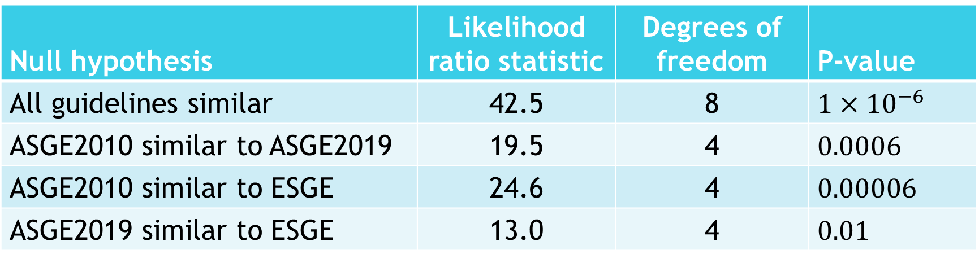
The Extensions: Comparing guidelines
Results (after fitting models under maximum likelihood):
Null hypothesis | Likelihood ratio statistic | Degrees of freedom | P-value
All guidelines similar | 42.5 | 8 | $$1×{10}^{−6}$$
ASGE2010 similar to ASGE2019 | 19.5 | 4 | $$0.0006$$
ASGE2010 similar to ESGE | 24.6 | 4 | $$0.00006$$
ASGE2019 similar to ESGE | 13.0 | 4 | $$0.01$$

Slide 22
The Extensions: Comparing guidelines
It may also be possible to evacuate parametric assumptions regarding the data by basing inference on sandwich variance estimators.
However, the number of clusters (studies) is small for this purpose, and the presence of weights complicates the matter, so we have not bothered.

Slide 23
Back to basics
Does any guideline stand out?
Guideline | Youden-optimal threshold | AUC | Se at threshold | Sp at threshold
ASGE2010 | 2.01 | 0.65 [0.58, 0.72 | 0.63 [0.55,0.71] | 0.59 [0.50,0.72]
ASGE2019 | 2.02 | 0.77 [0.68,0.84] | 0.63 [0.51,0.74] | 0.80 [0.69,0.82]
ESGE | 2.25 | 0.75 [0.62,0.85] | 0.60 [0.46,0.74] | 0.91 [0.82,0.96]

Slide 24
Before we stop, an aside
Pimp that package!

Slide 25
Thank you, & questions if any

